Slide 1
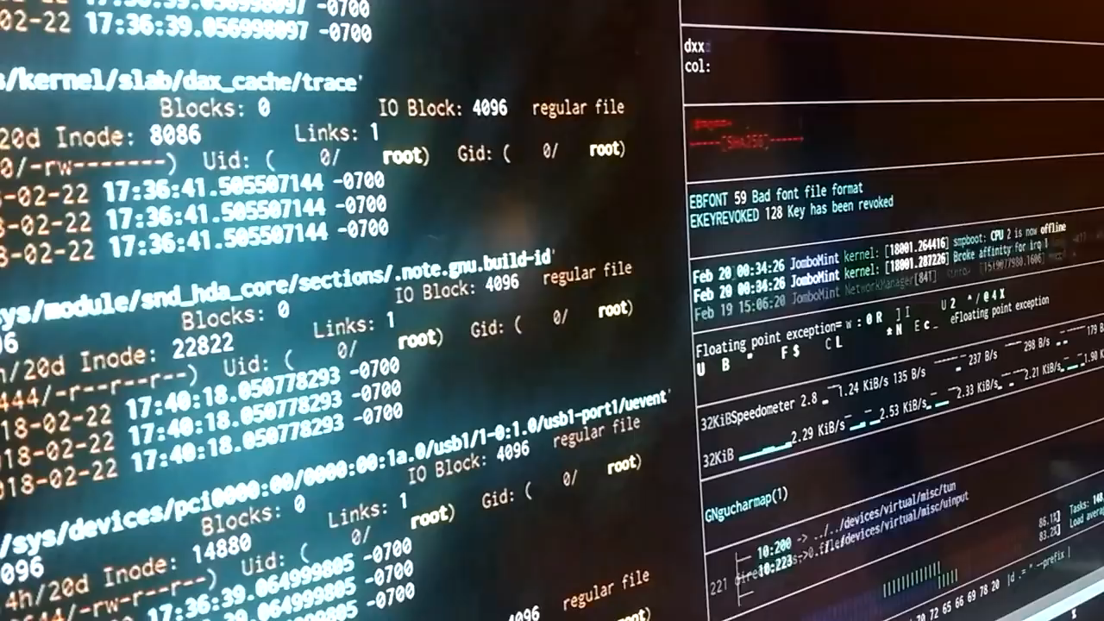
EDIBO PROJECT!
Notes:
This template was inserted from Power-user, the productivity add-in for PowerPoint, Excel and Word.
Get thousands of templates, icons, maps, diagrams and charts with Power-user. Visit https://www.powerusersoftwares.com/!

Slide 2


“Make it work, make it right, make it fast”
Theory
Technics
Practice
Notes:
This template was inserted from Power-user, the productivity add-in for PowerPoint, Excel and Word.
Get thousands of templates, icons, maps, diagrams and charts with Power-user. Visit https://www.powerusersoftwares.com/!

Slide 3


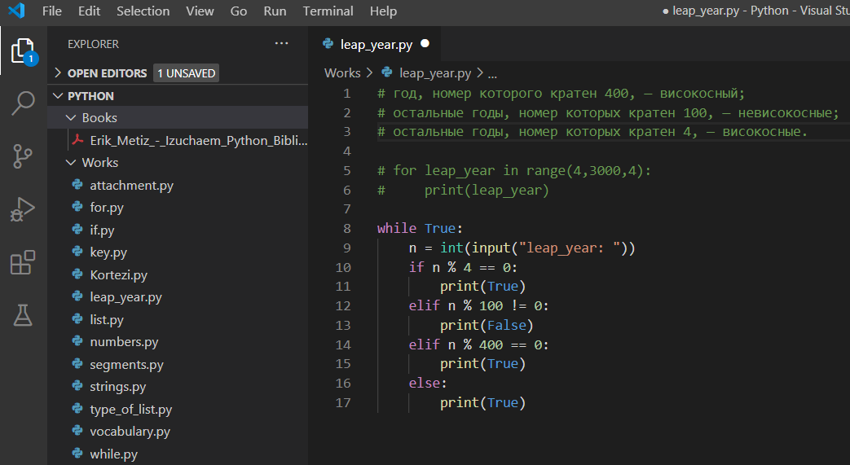
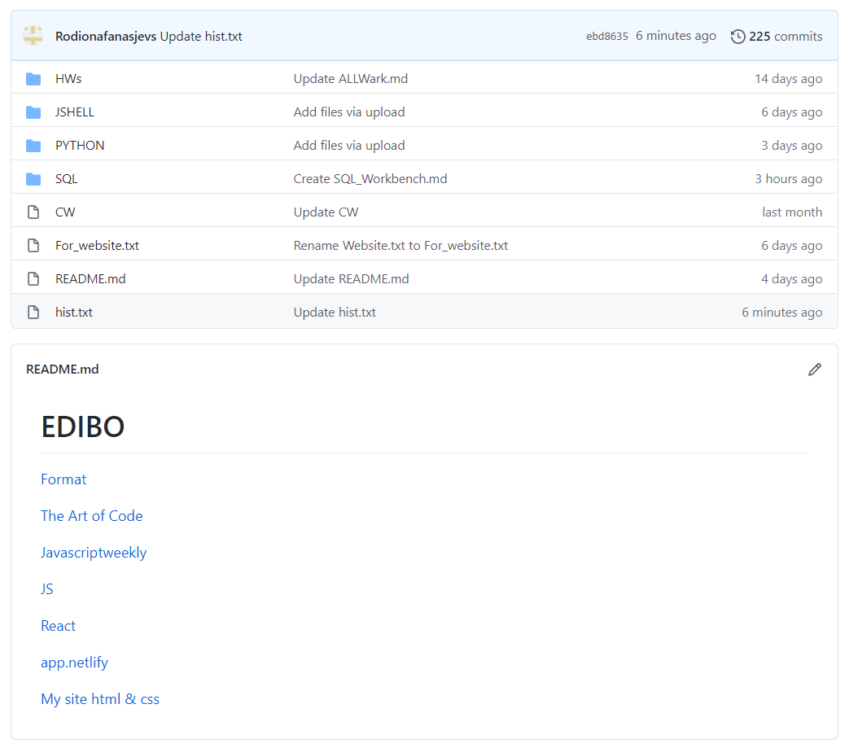
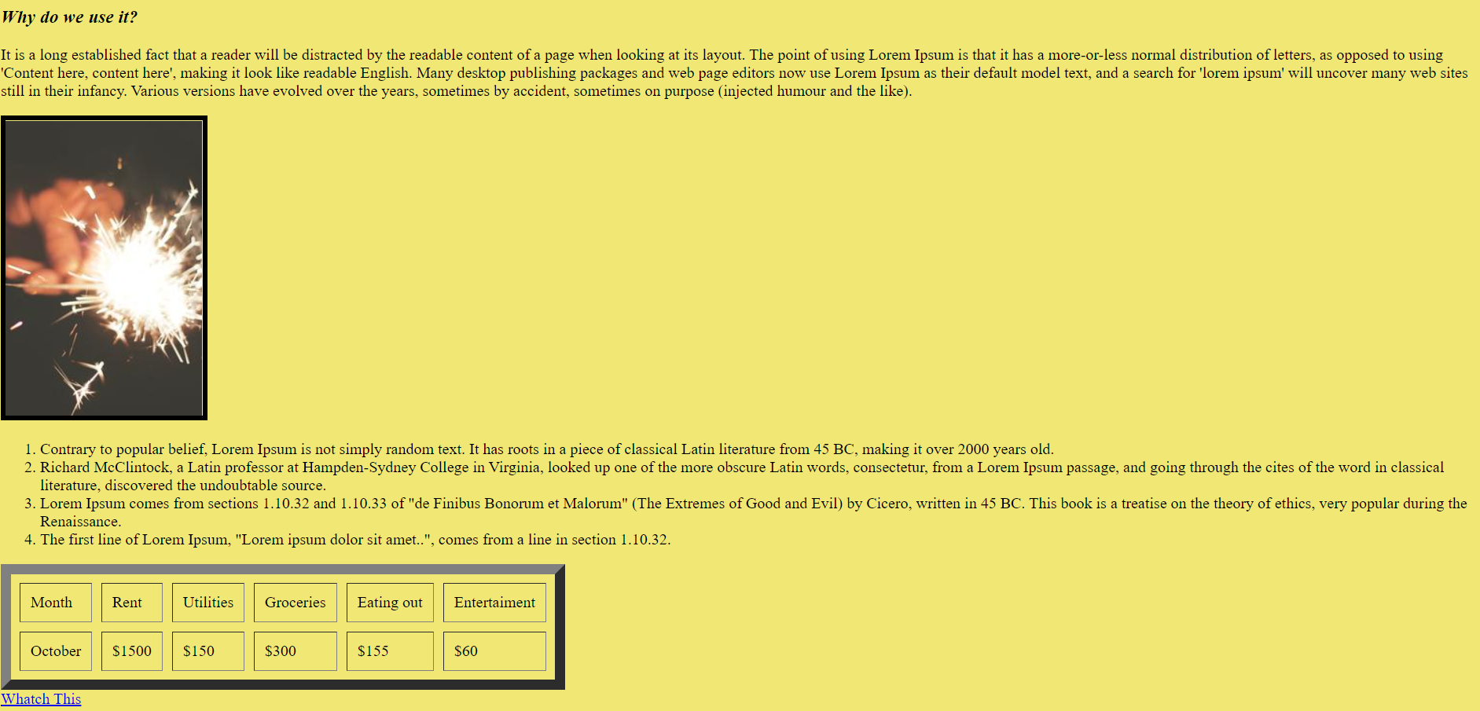
LESSONS
https://rodionafanasjevs.github.io/Lorem_Ipsum/index.html

